Slide 1
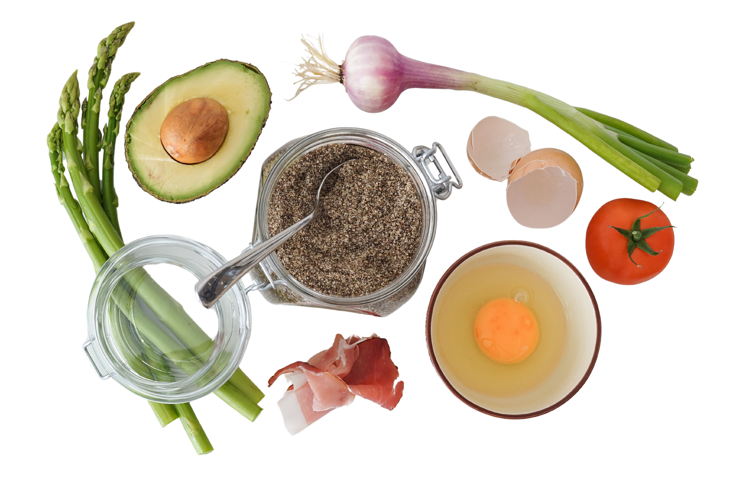


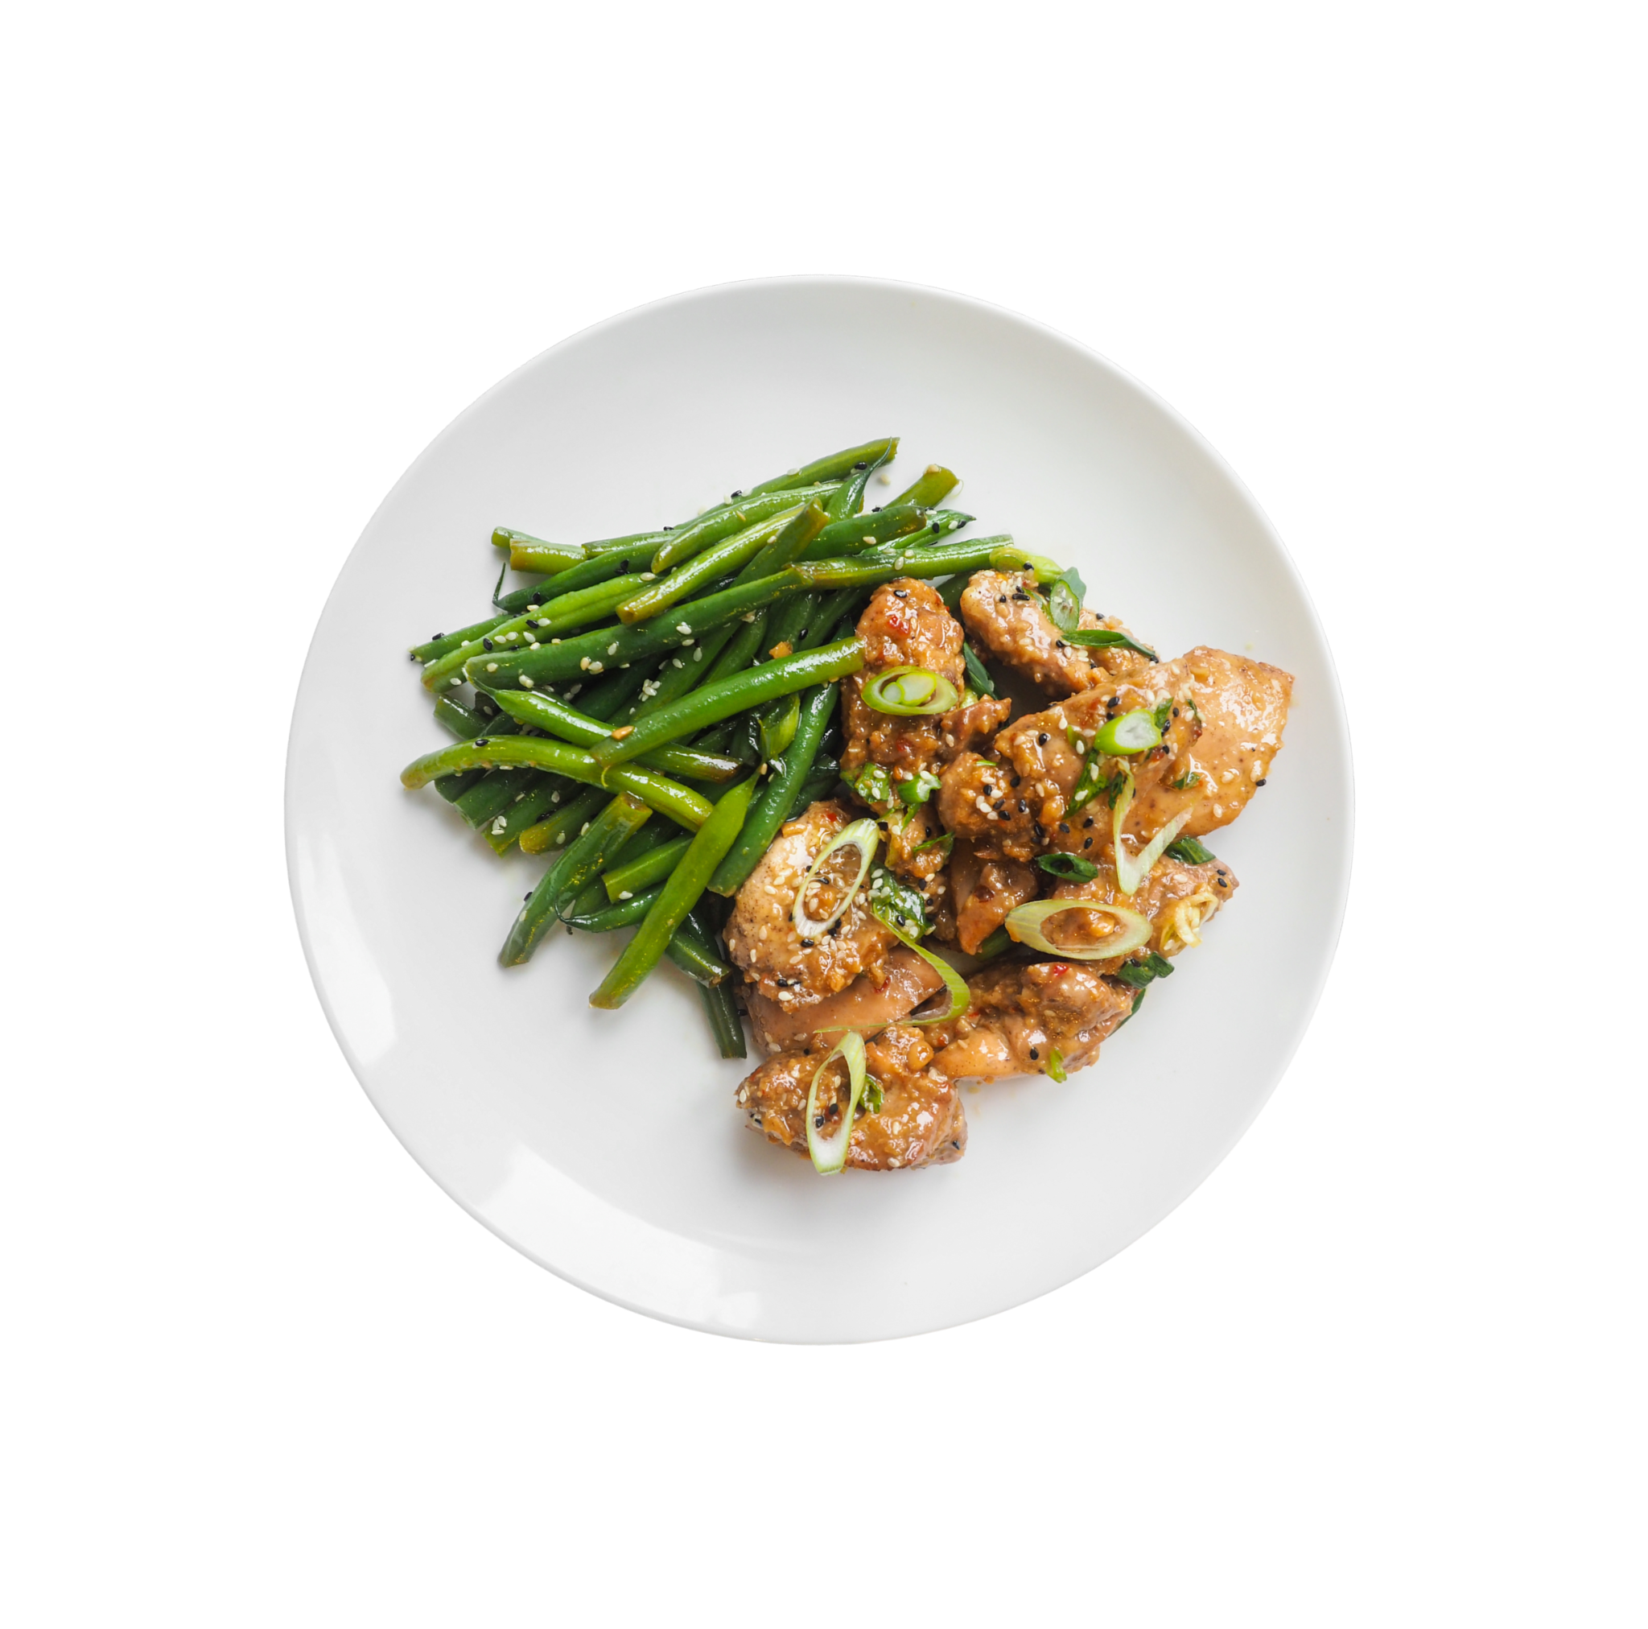

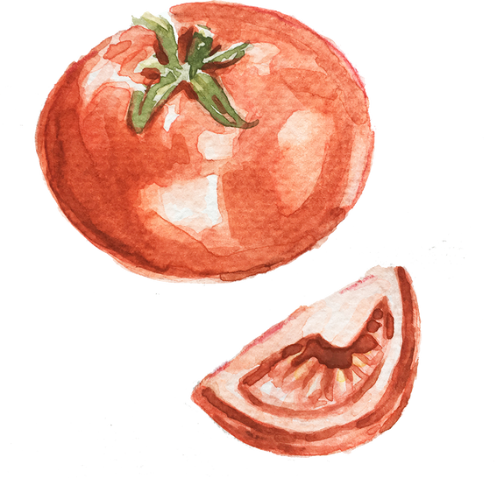

WHAT’S COOKING APP

Slide 2



Presented by
Koleti Samhitha
Koribilli Srikanth
K K Supriya
K Supriya
M Harini
Nayana A
Nulu Rohini Sree
.

Slide 3

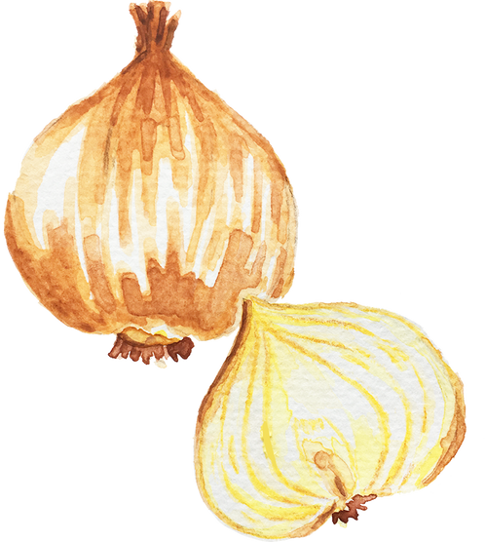

Contents
Introduction
Objective
Tools & Languages Used
Features of whats cooking app
Advantages
6.Flow chart
7.Screen Shots Of Output and details
8.Conclusion

Slide 4
INTRODUCTION
Finding the time and inspiration to create delicious and wholesome meals can be a challenge. Busy schedules, overwhelming choices, and the need for convenience often lead to repetitive and uninspiring meals.
This is where our whats cooking app steps in. We understand the struggle and aim to solve the problem of finding a recipe by providing a solution that makes cooking enjoyable and accessible to your preferences.
Our app transforms the kitchen into a space of creativity and exploration, ensuring that every meal is not just a necessity but a delightful experience.

Slide 5






OBJECTIVES
Enhance User Experience
Recipe Discovery
Promote Healthy Eating.

Slide 6



Features of App
User Friendly
Cooking Tips and Techniques
This app is easily compatible with most of the web browsers.
User can comment on the Recipe
Admin can upgrade the recipes according to the user comments

Slide 7


Advantages
Diverse Recipe Collection
Cooking Guidance
Feedback and Improvement
Motivation for healthy home cooking
Convenience and Accessibility

Slide 8
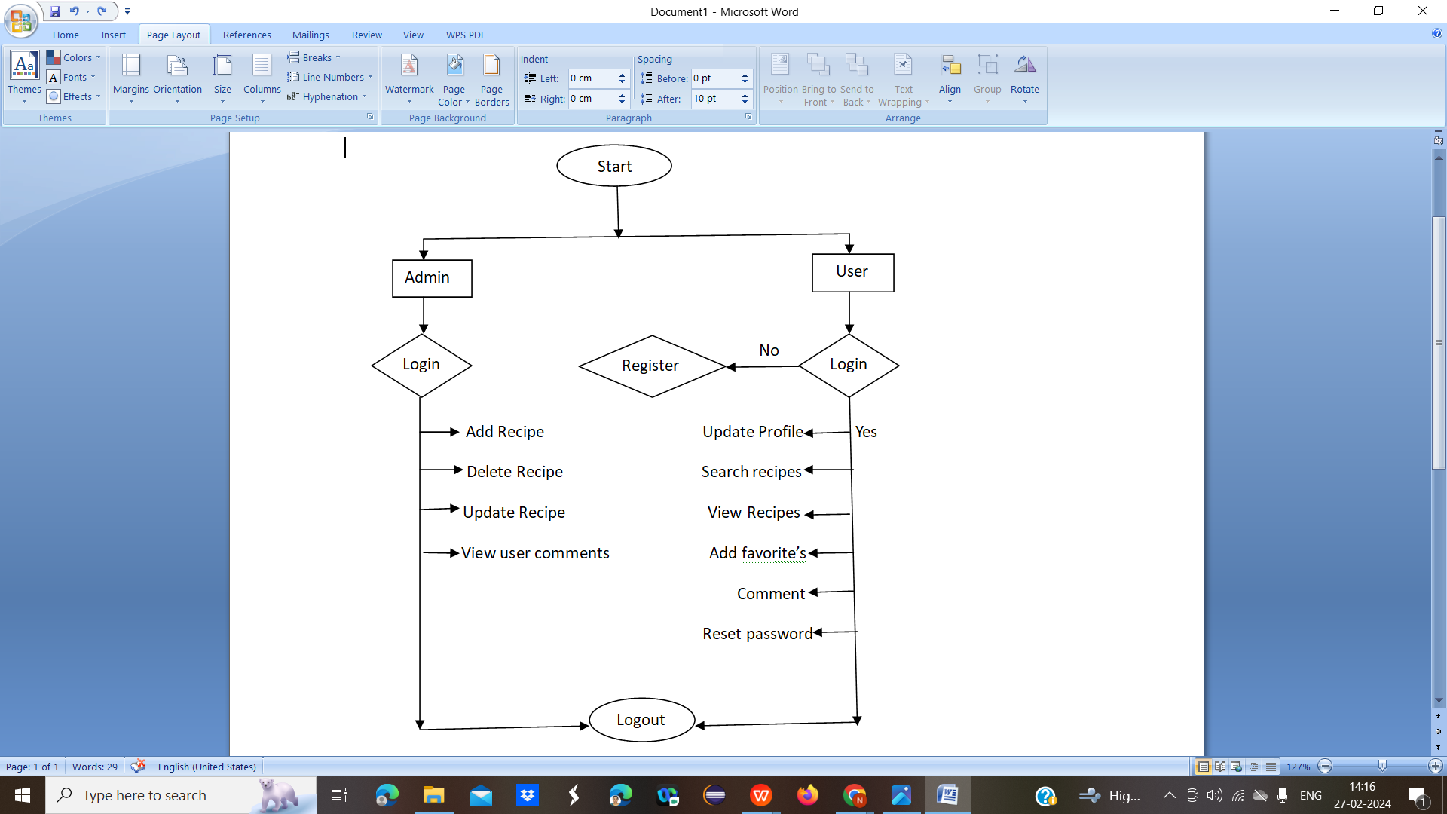
Flow Chart
.

Slide 9
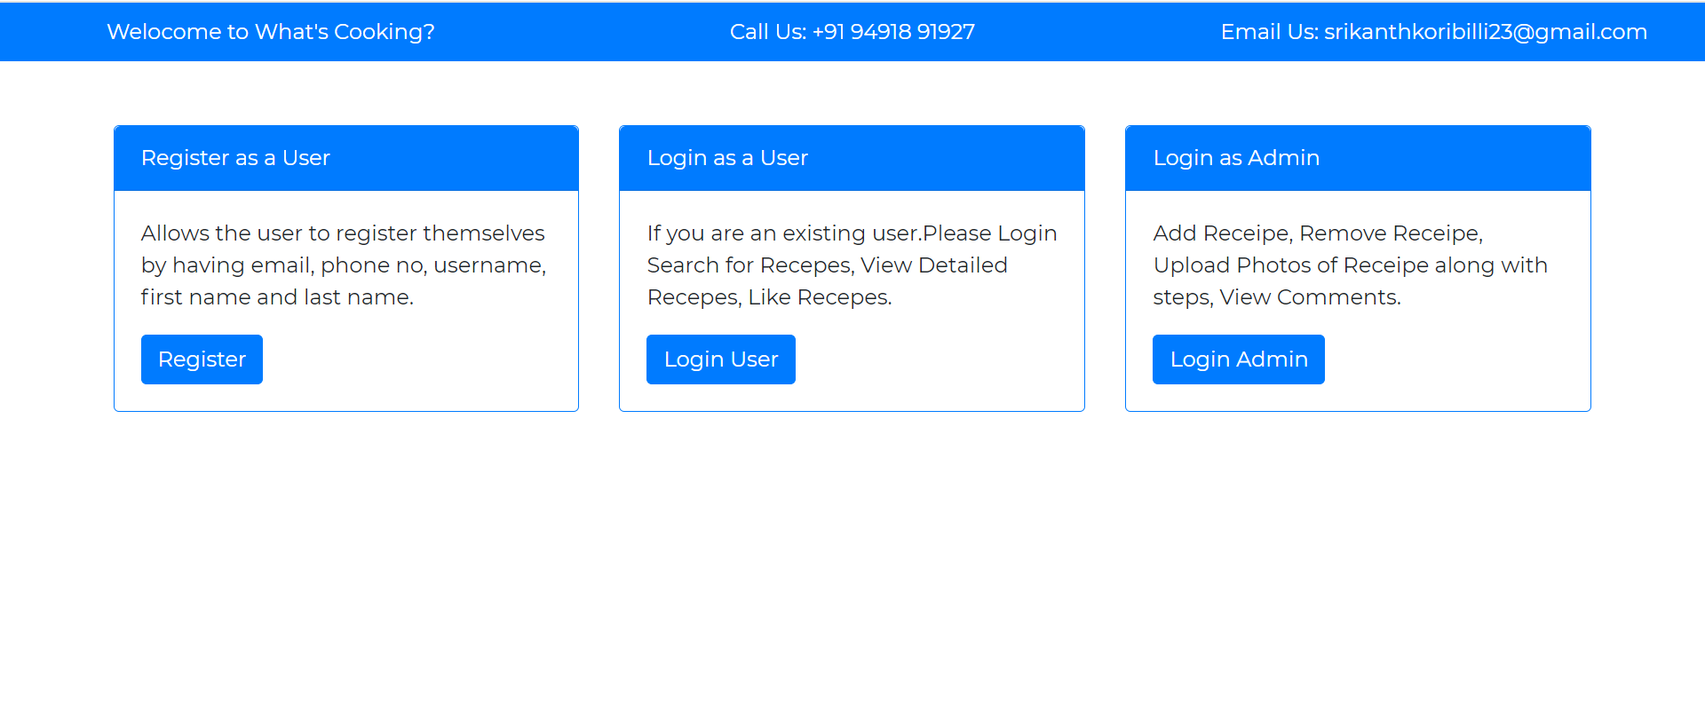
Screenshots Of Output and Details
HOME PAGE:
.

Slide 10
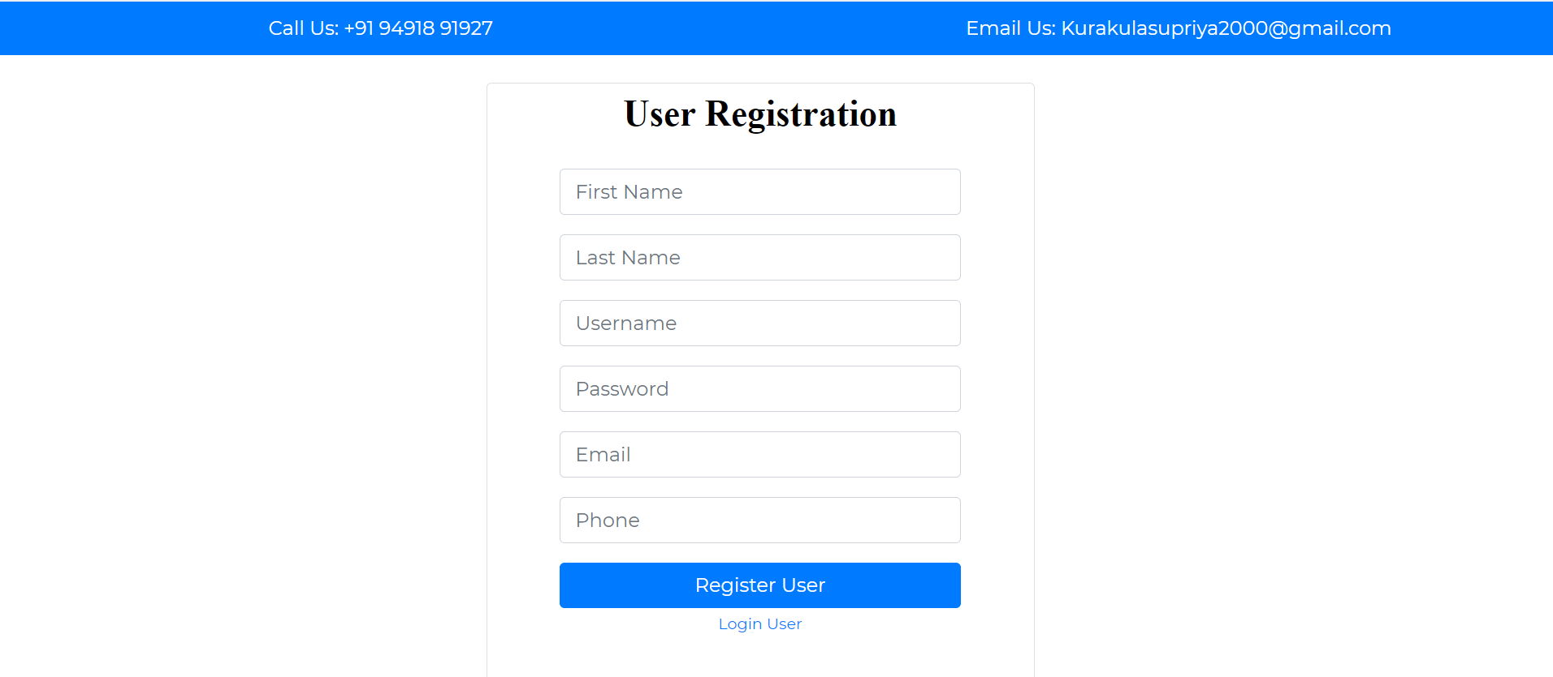
REGISTRATION PAGE:
.

Slide 11
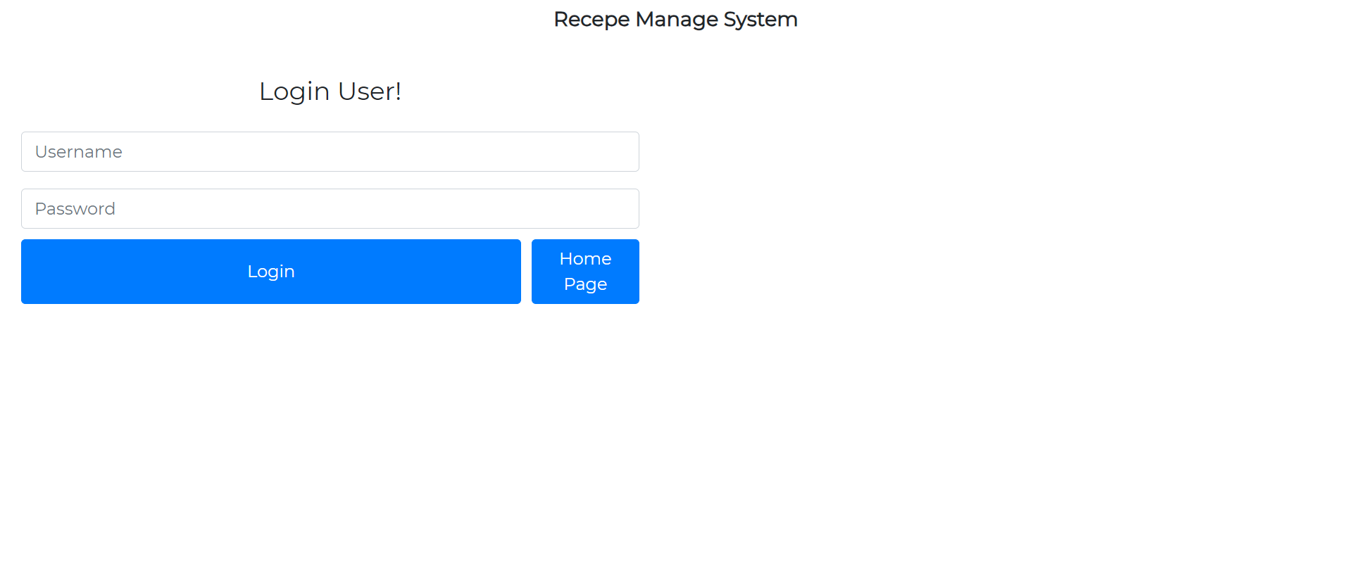
USER LOGIN:

Slide 12
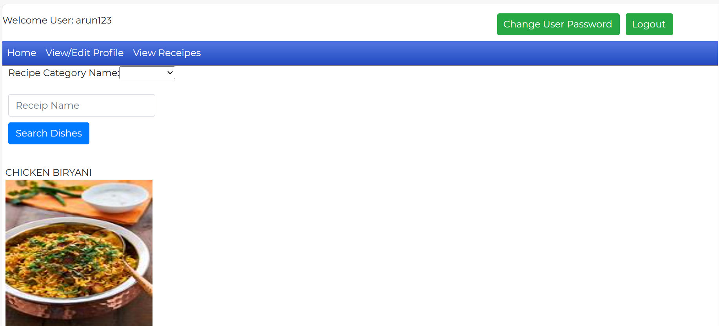
USER RECIPE:

Slide 13
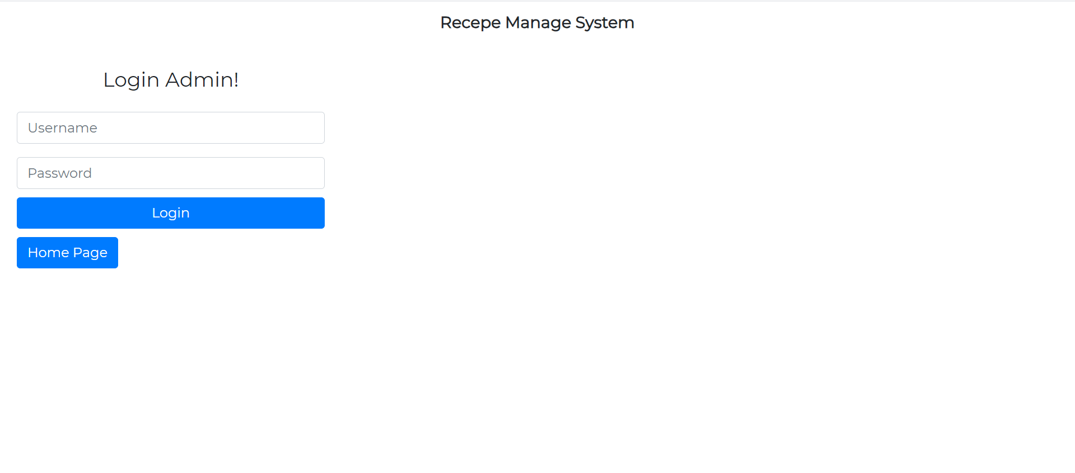
ADMIN LOGIN:

Slide 14
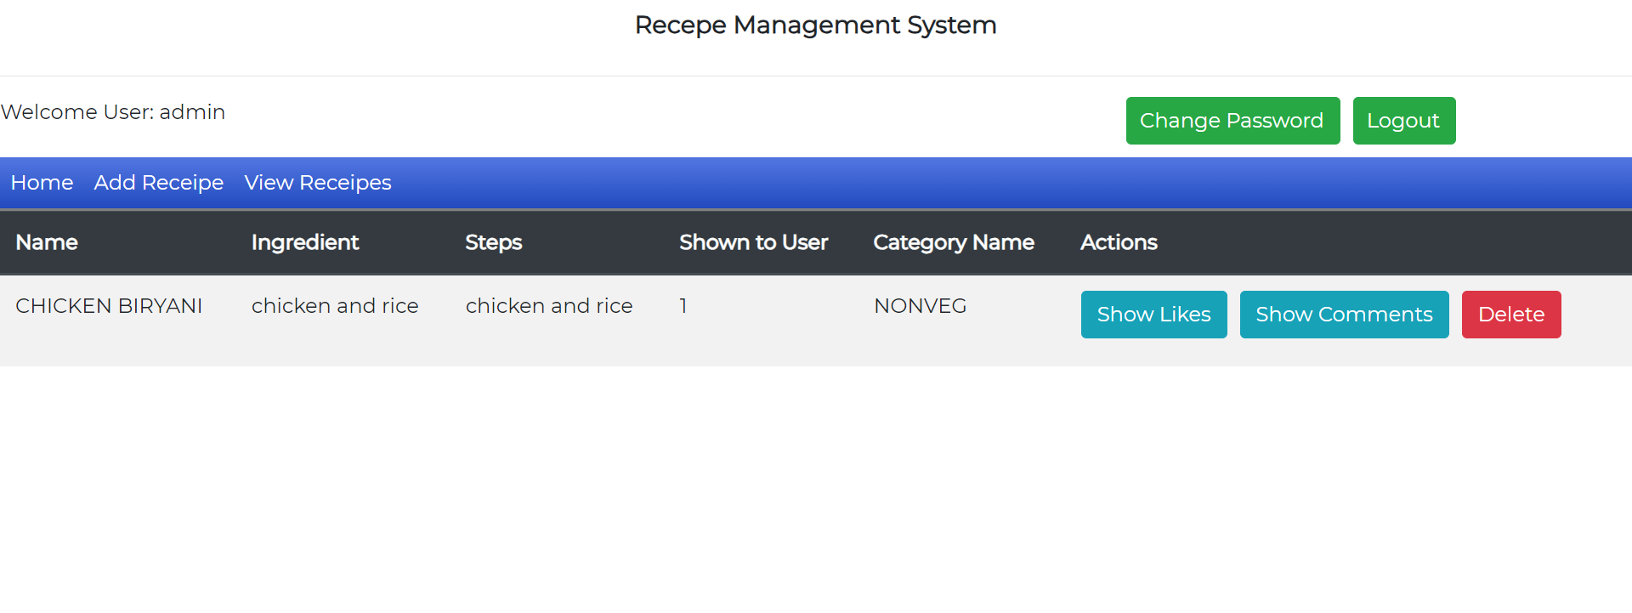
ADMIN RECIPE:

Slide 15

USER REGISTRATION&USER LOGIN
User Registration:User can register by giving their details.
User Login:User can Login with registered email and password.And also user can update his/her password.

Slide 16

UPDATE PROFILE/SEARCH
Update profile :User can view and update the profile.
Search:User can search the required recipes.

Slide 17

ADD FAVOURITE/COMMENT
Add favourite :User can select recipes and they can add to their favourites.
Comment:User can give review to the recipes.

Slide 18
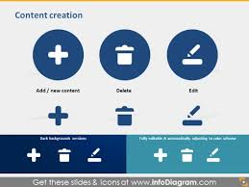
ADMIN LOGIN &ADD/DELETE/UPADTE/VIEW
Admin Login:Admin can Login with their email and password.
Add:Admin can add recipe details.
Delete:Admin can delete recipes.
Update:Admin can update the recipes.
View:Admin can view the user comments.

Slide 19
CONCLUSION
In conclusion, the "What's Cooking" app is a culinary companion designed to transform the way individuals approach home cooking.
"What's Cooking" app is more than just a cooking assistant; it's a companion that empowers individuals to create, share, and savor memorable moments through the joy of home cooking.
Happy cooking!

Slide 20
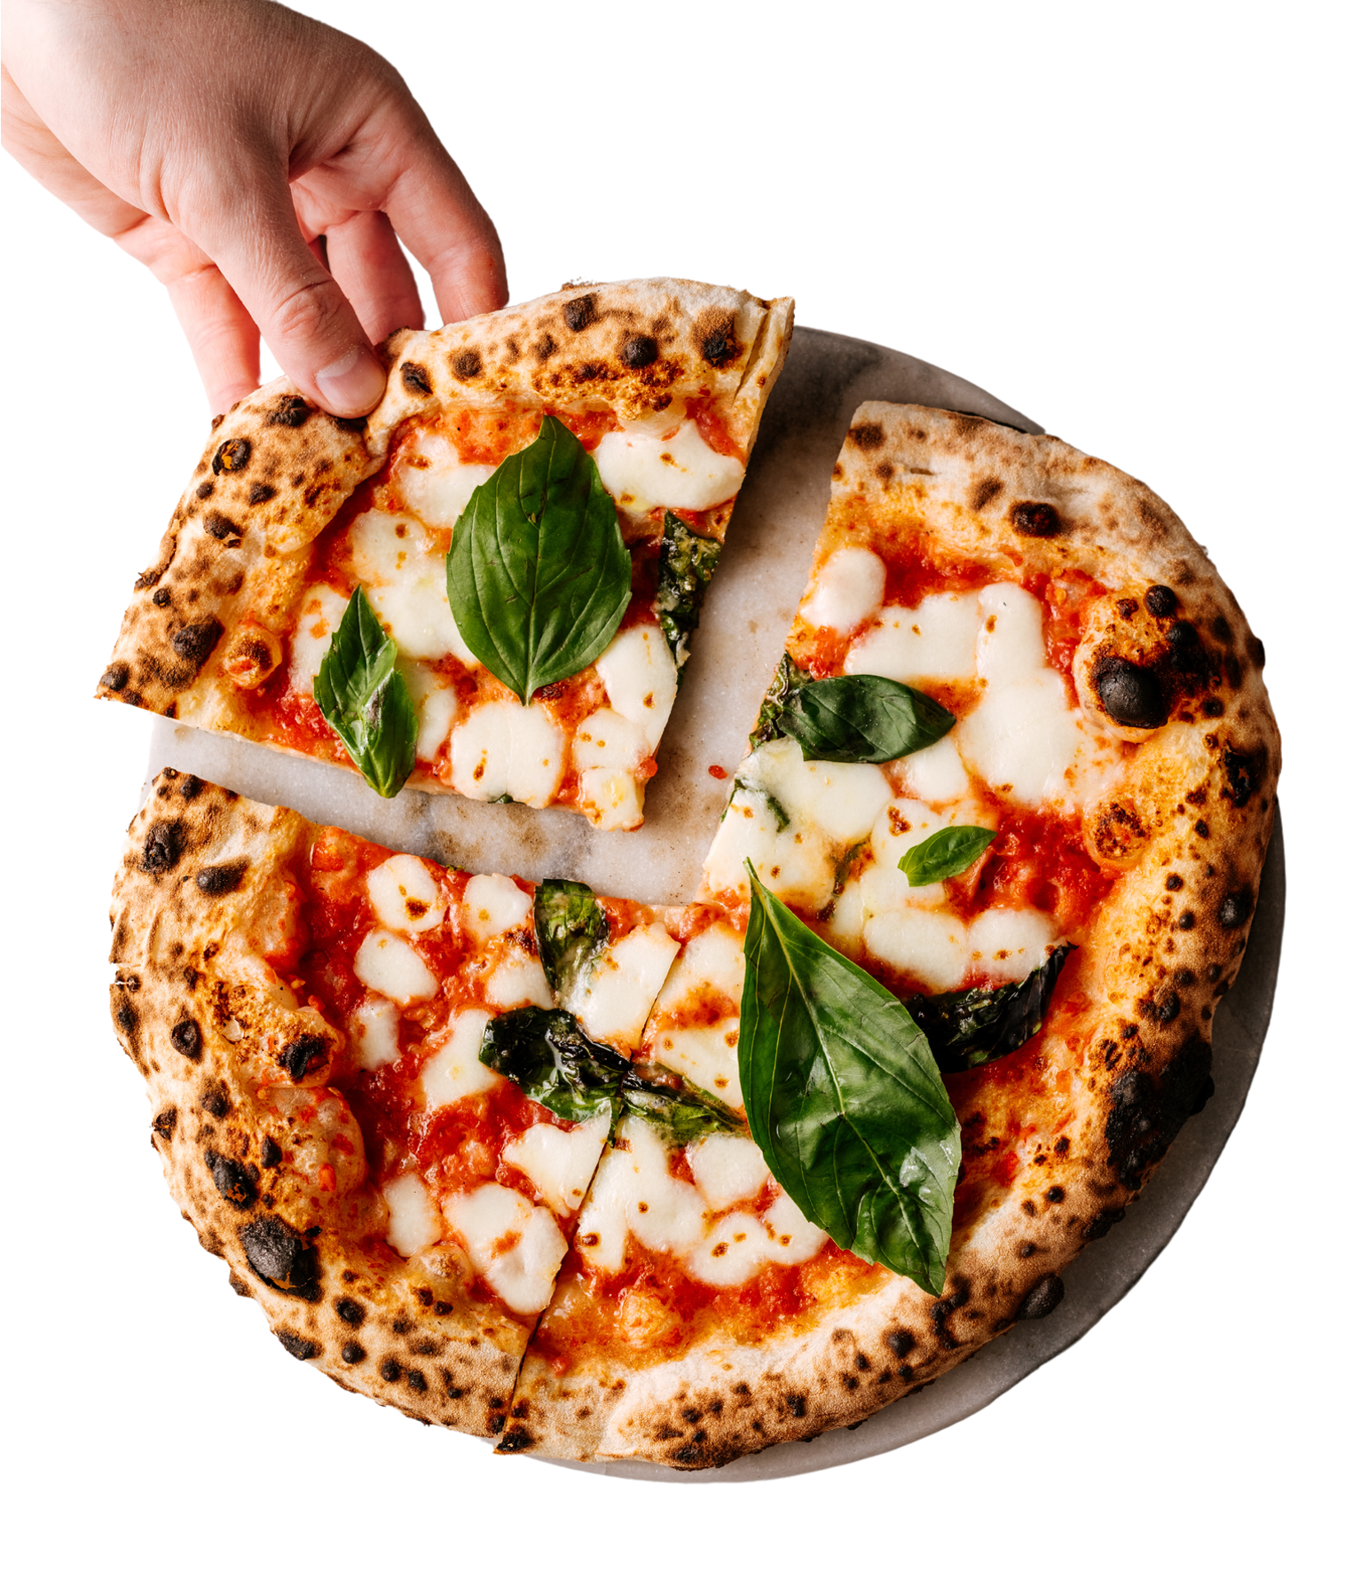
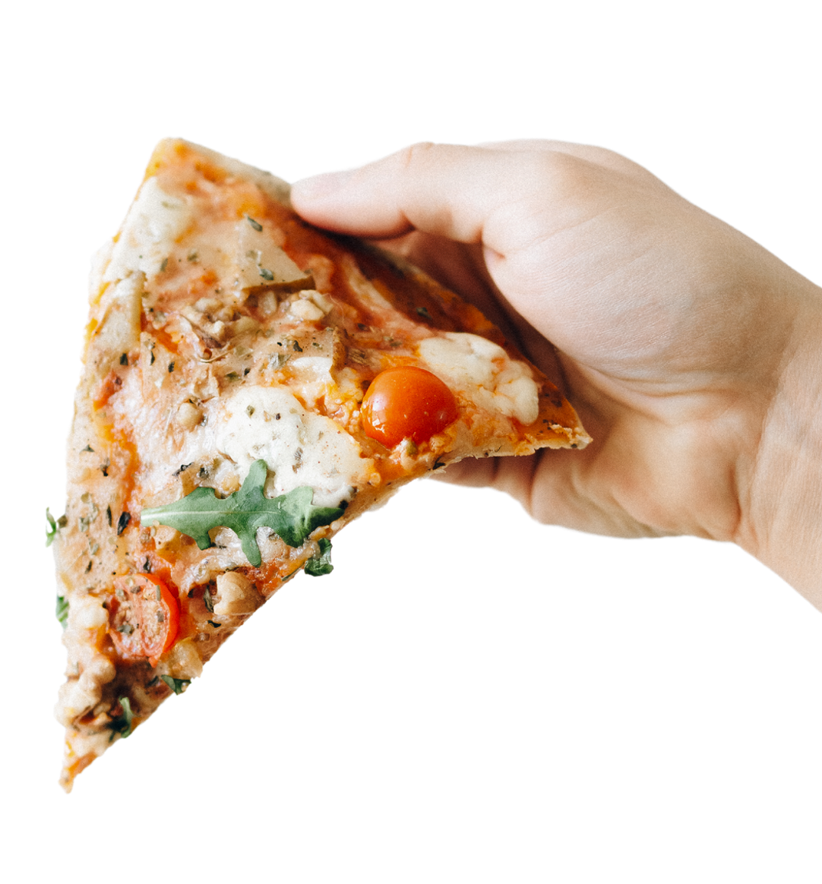


THANK YOU.

